Slide 1

Traffic Light Management System
Team #4
Saleem Hamo (2944943H)
Omar Abdelkrim (2931789A)
Alexandru-Mihai Sava (2955854S)
Miguel Rosa (2849121R)

Slide 2

The average person throughout their lifetime spends
FIVE YEARS
waiting in lines and queues
where roughly
SIX MONTHS OF THAT
is waiting for traffic signals to change
How Much Time People Spend Doing Stuff In Their Lifetime
Malta Daily: The average person waits spends six months of lifetime waiting for traffic signals to change

Slide 3
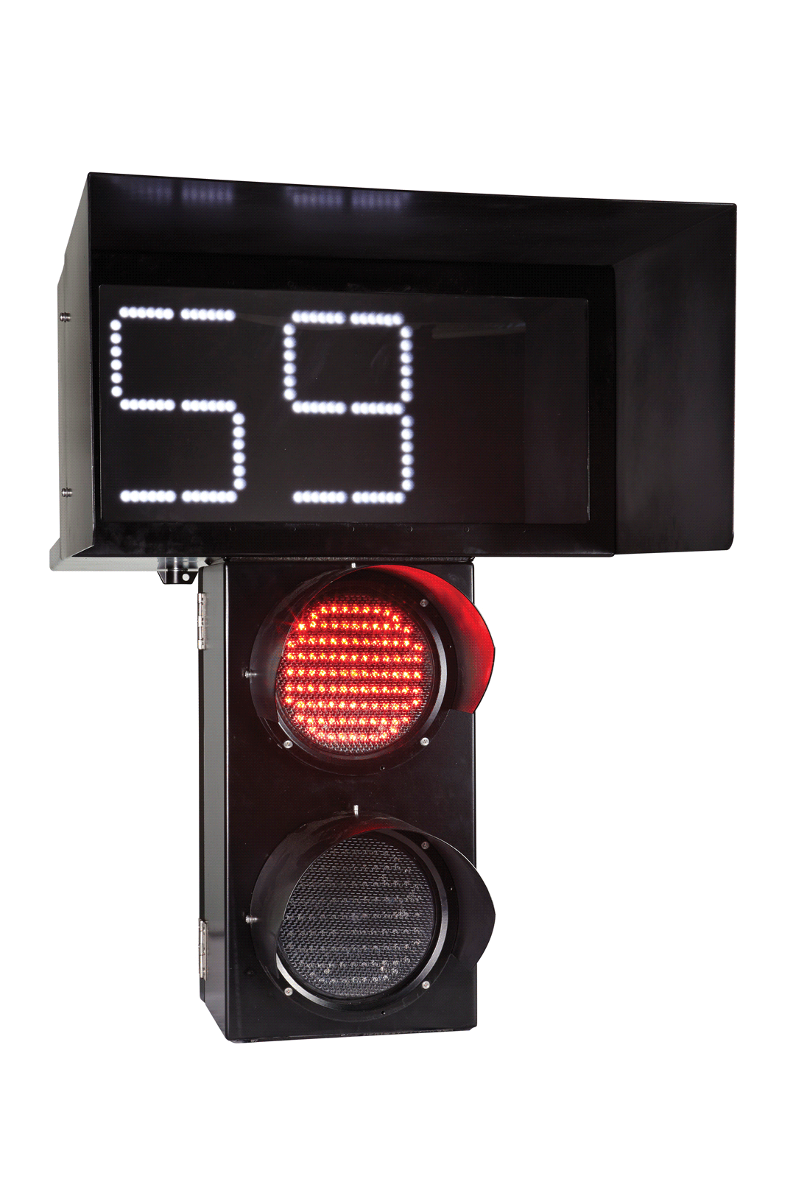
How long does it take lights to change?
Usually fall between 45 and 120 seconds
based on traffic volume and traffic patterns
Glasgow councillor says pedestrian crossing waiting time
‘should only be 30 seconds’
New York City DOT
Glasgow World

Slide 4

People don’t wait
They just walk…
No matter if it was safe or not

Slide 5

Approximately 1.19 million people die each year because of road traffic crashes
More than half of them are pedestrians
an average of 8 pedestrians died and 115 were seriously injured (adjusted) per week in reported road collisions.
most pedestrian fatalities (56%) do not occur at or within 20m of a junction
Road traffic injuries
Reported road casualties Great Britain: pedestrian factsheet 2021

Slide 6
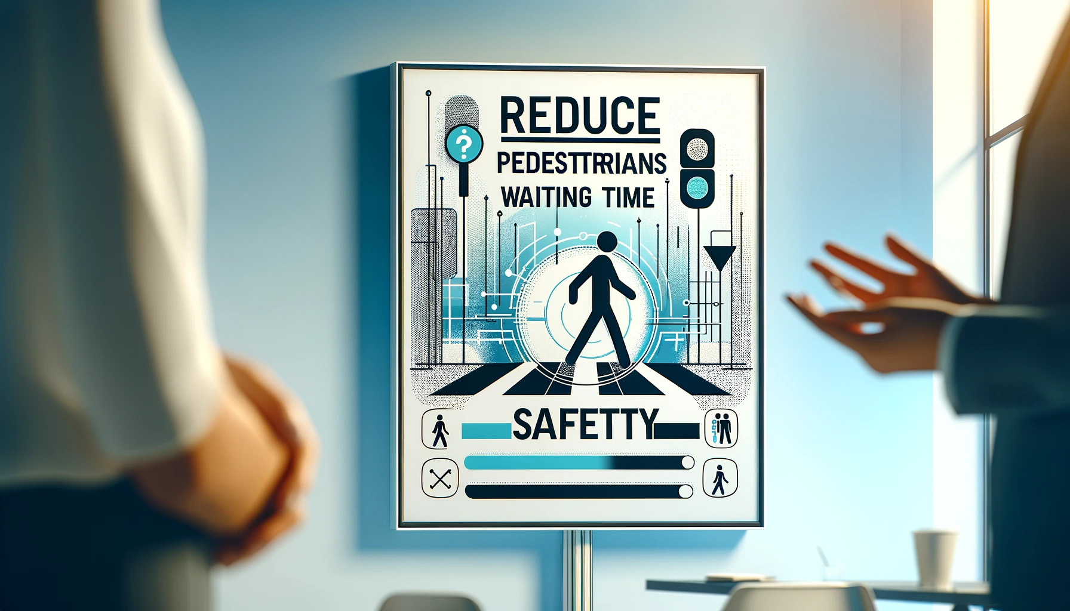
We will focus on

Slide 7

Real-time Response?
Response time for pedestrians will be lower than the standard loop time.
If there is no oncoming traffic, the pedestrian will receive the right of way.
Immediate response time to the pedestrian trying to cross when there is incoming traffic.

Slide 8
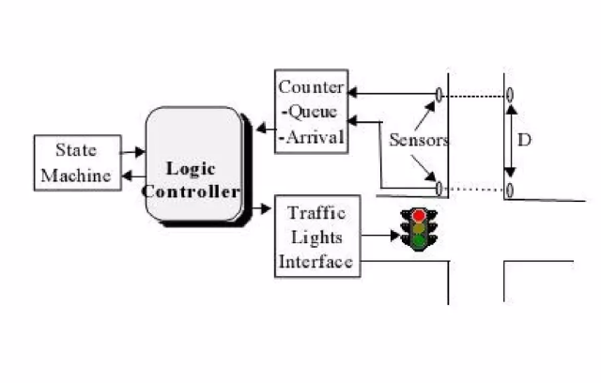
Standard System

Slide 9
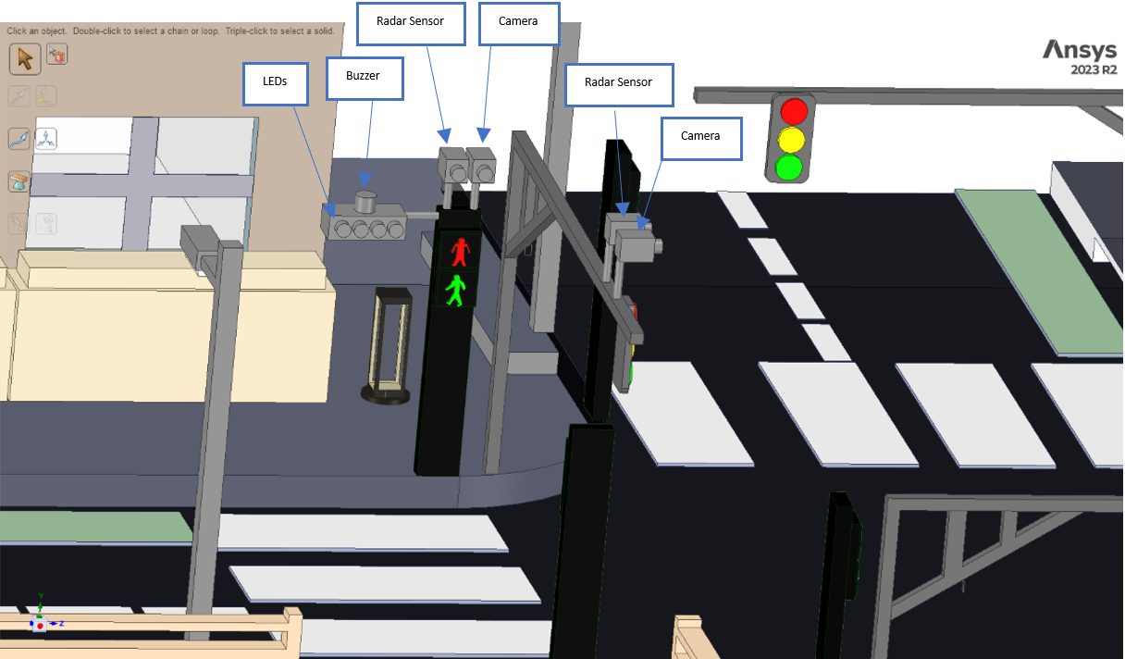
Model

Slide 10
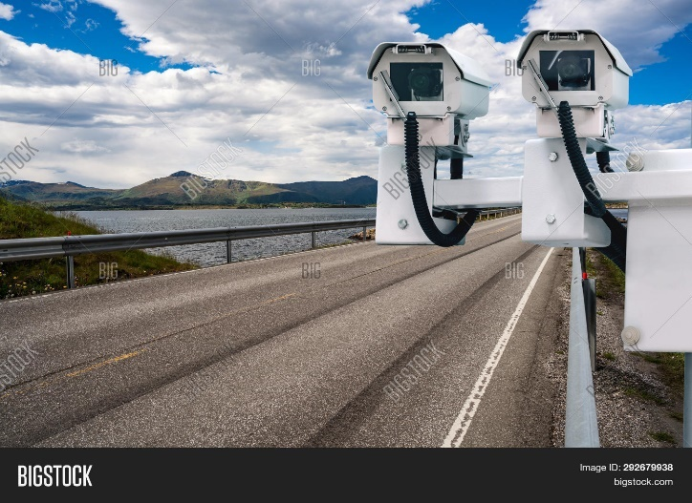
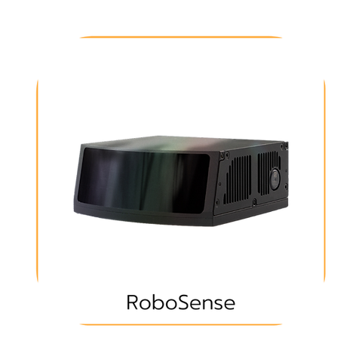
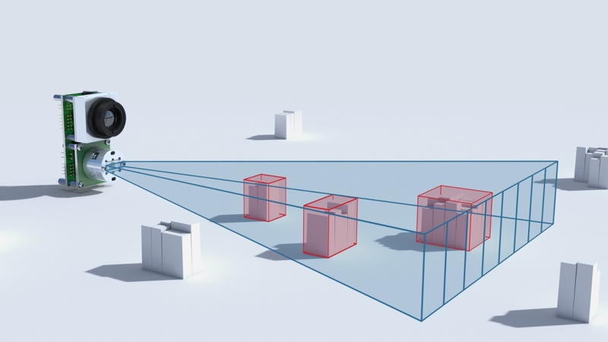

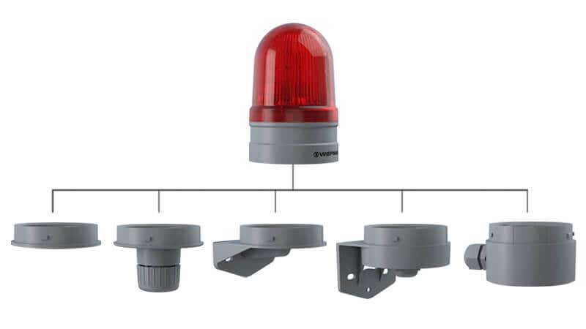
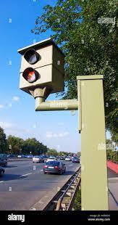
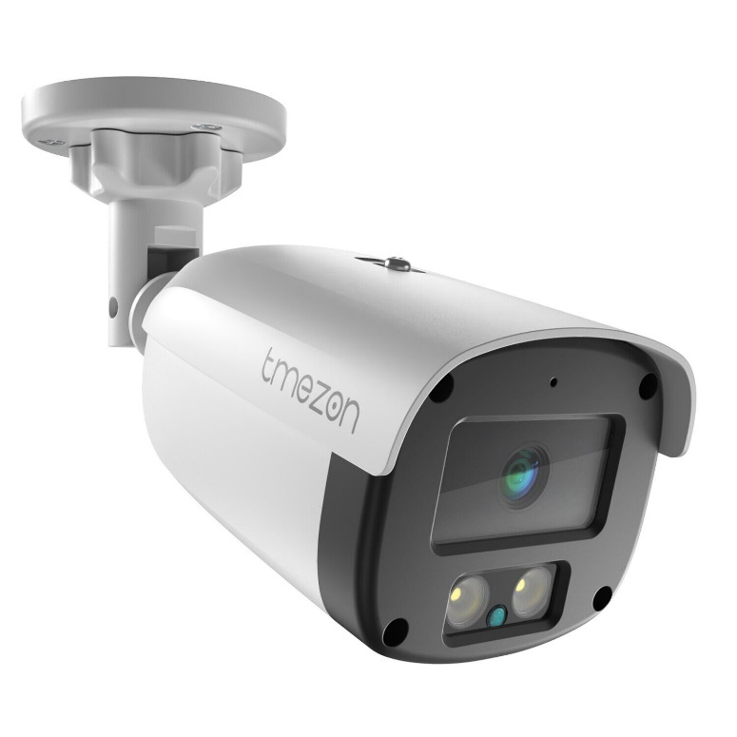

Slide 11
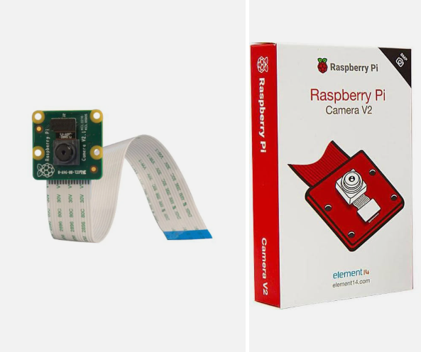

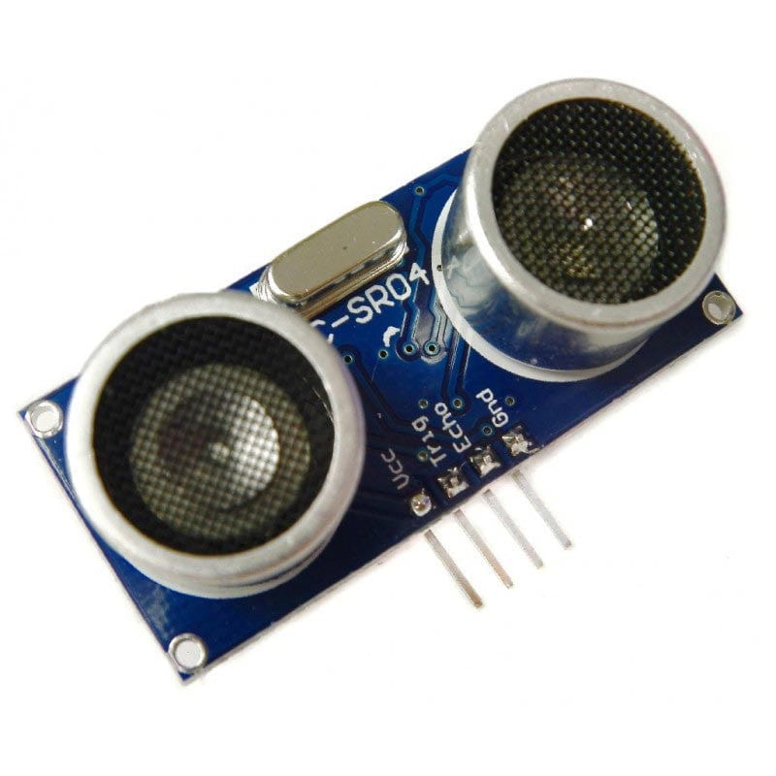
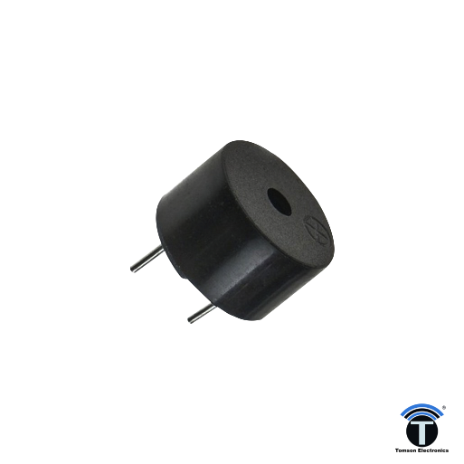

Slide 12

Embedded Software Architecture for Traffic System
RTOS Integration: Implement FreeRTOS/PREEMPT_RT for responsive traffic control.
IPC for Efficiency: Utilize sockets/shared memory for component communication.
MQTT Protocol: Lightweight network communication for sensor data.
Computer Vision: Basic OpenCV for traffic detection with Raspberry Pi camera.
GPIO Control: Python-based control of LEDs and buzzer.
GitHub & CI: Version control and automated testing for robust software management.
Modular Design & Unit Testing: Independent module development and testing for reliability.
Data-Driven Approach (optional): Logging traffic data for future optimization.

Slide 13
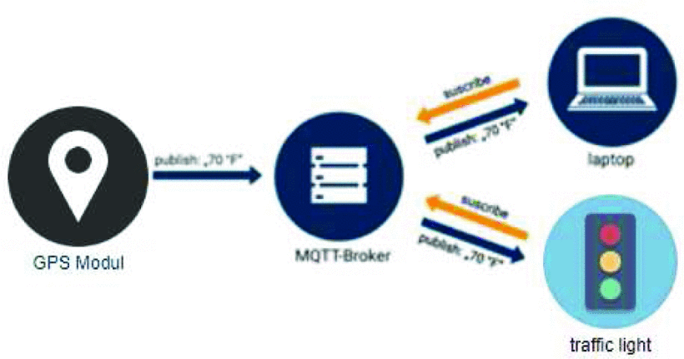
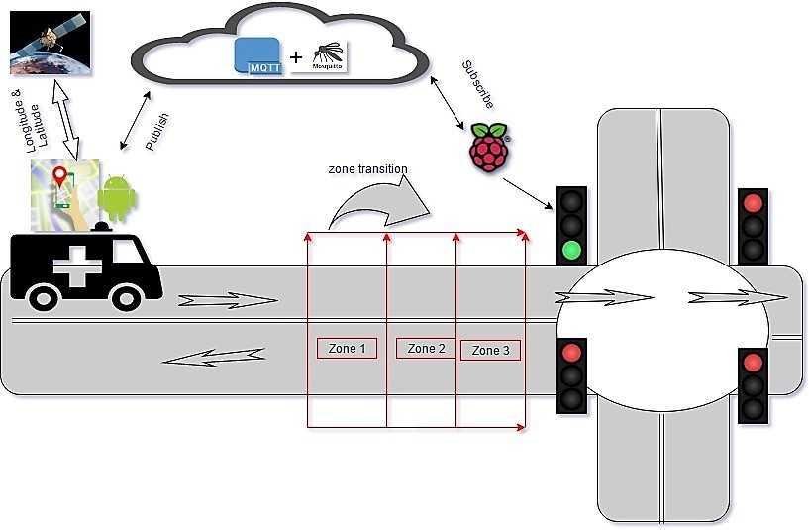
Inter-Process Communication (IPC):
Sockets:
Facilitates communication over a network.
Ideal for distributed control between different system components.
Shared Memory:
Enables high-speed data sharing by accessing a common memory space.
Best suited for real-time, efficient data exchange.
Message Queues:
Allows structured communication through sending and receiving messages.
Ensures orderly and manageable inter-process communication.
Network Communication - MQTT (Message Queuing Telemetry Transport):
A lightweight messaging protocol.
Suitable for small devices and low-bandwidth networks.
Ensures reliable message delivery in IoT applications.

Slide 14
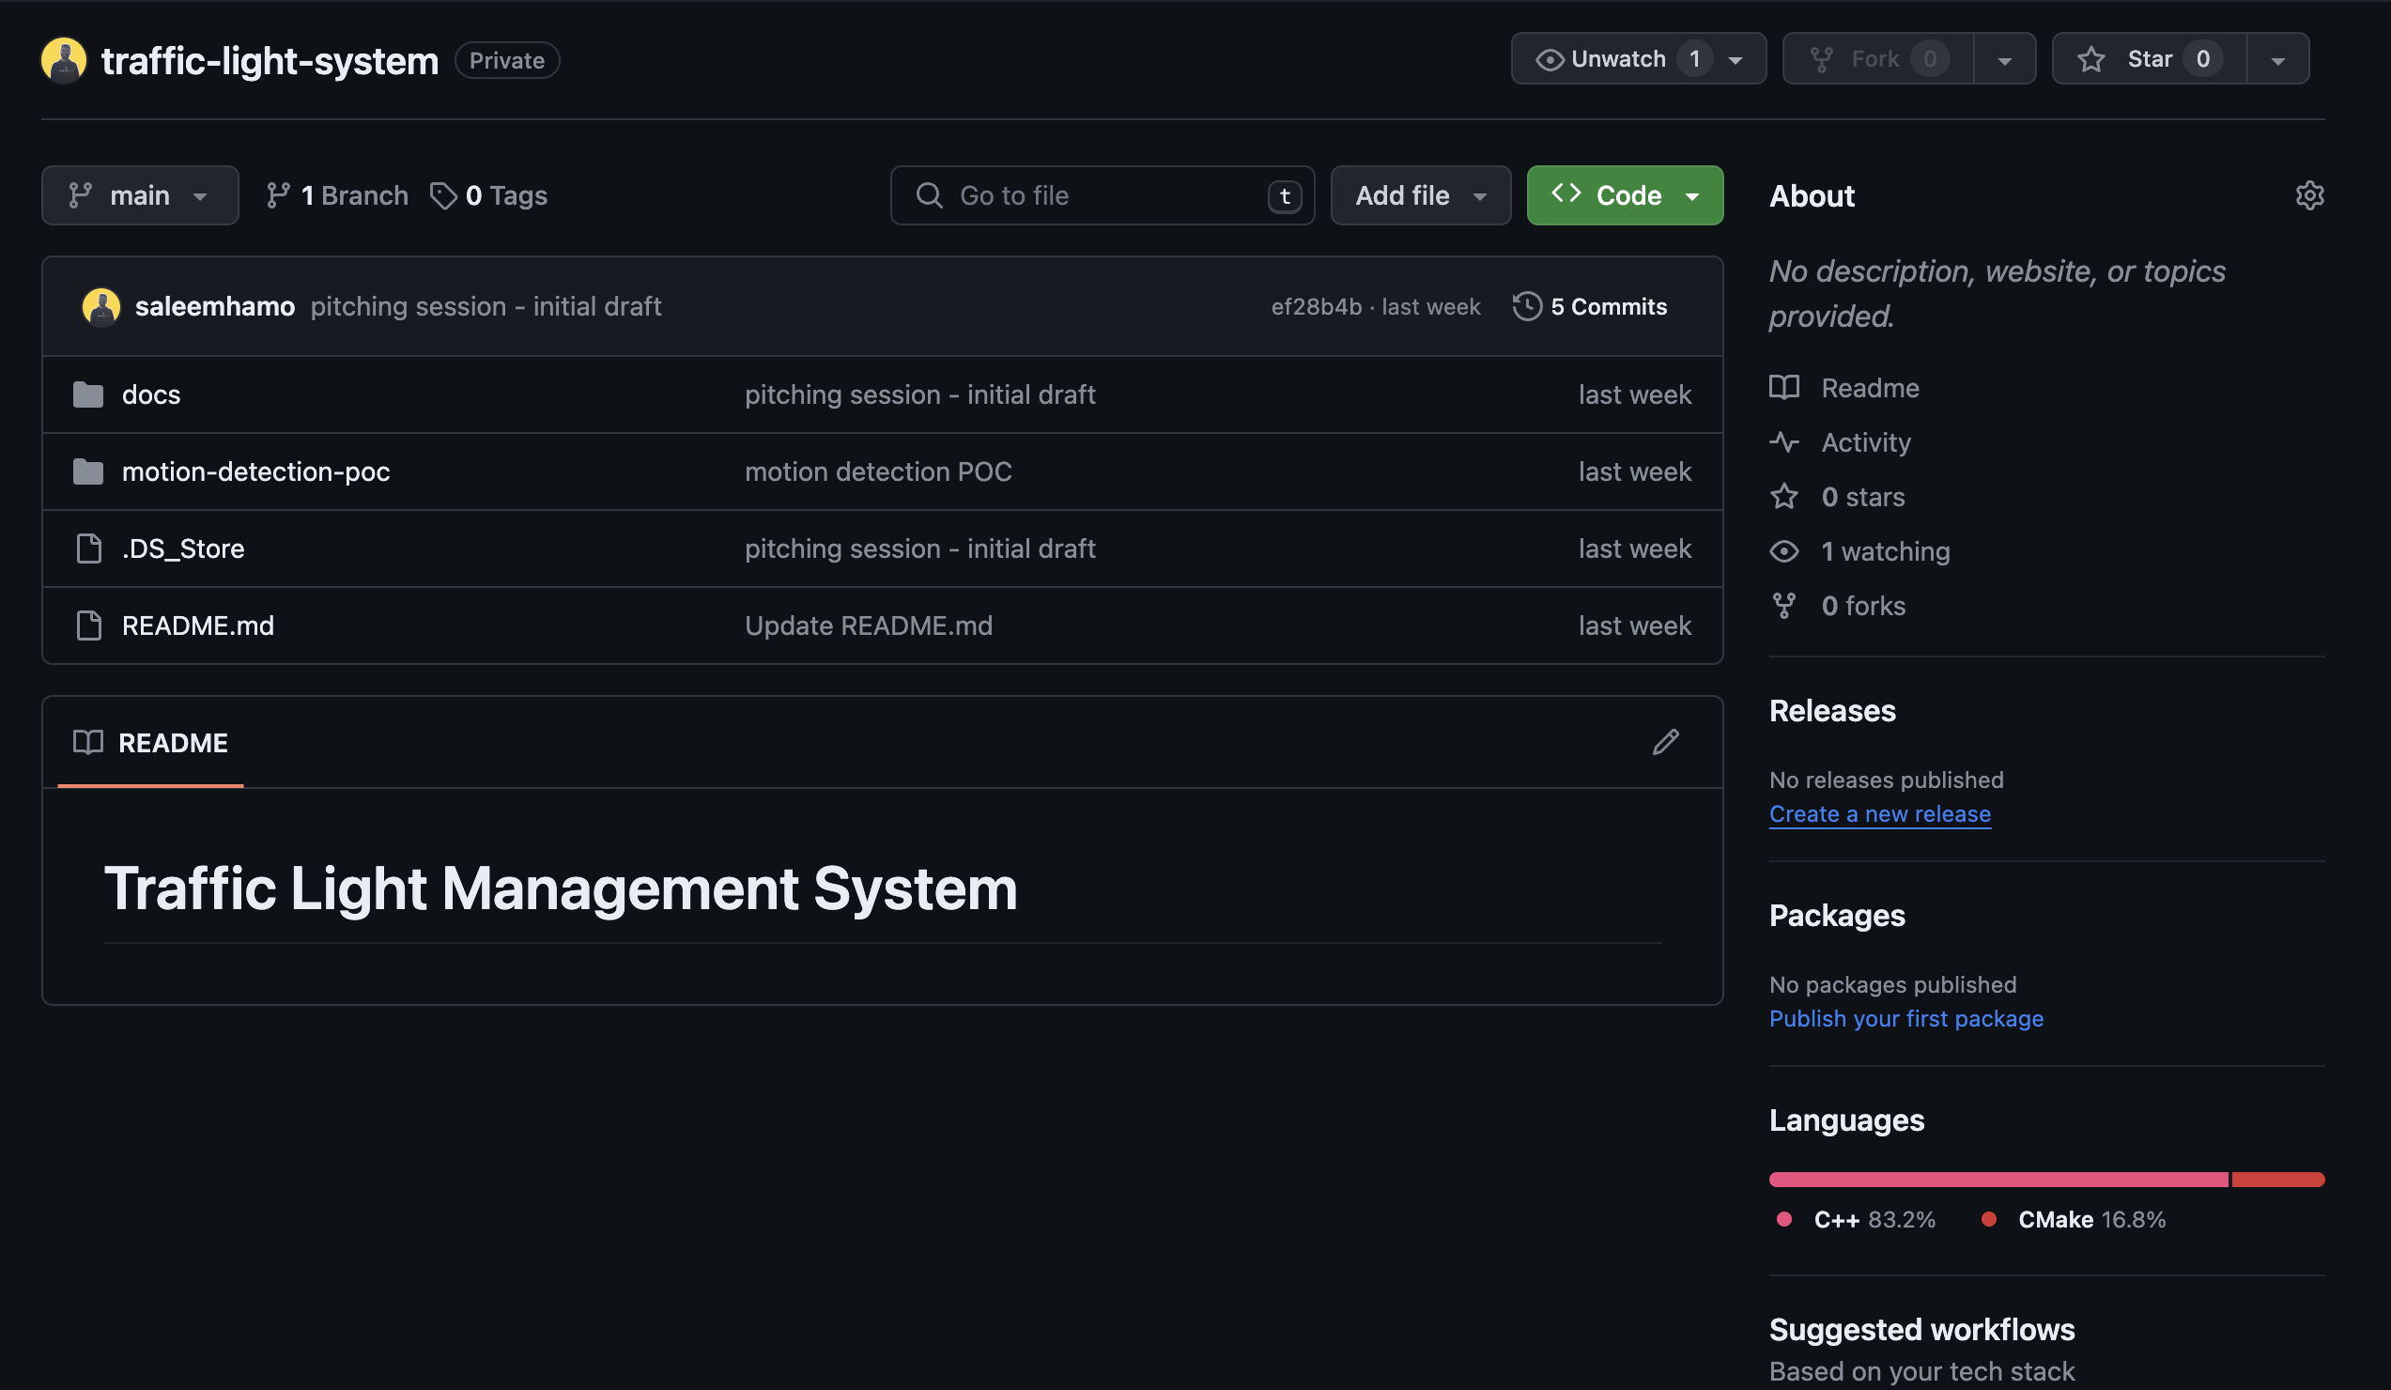
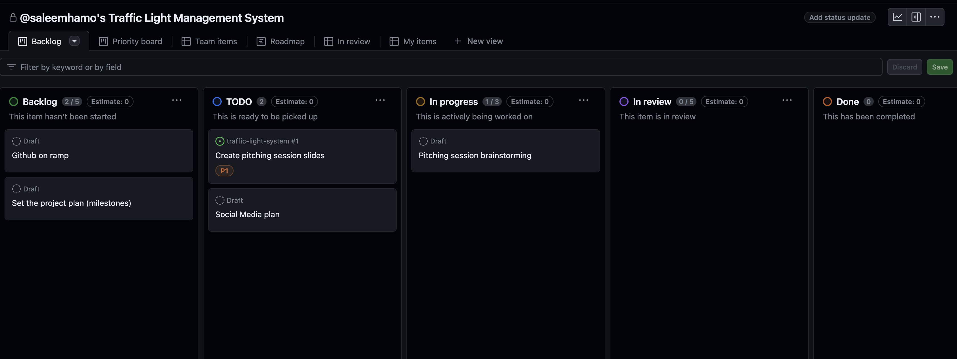
Github repository and project

Slide 15
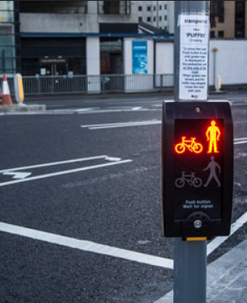
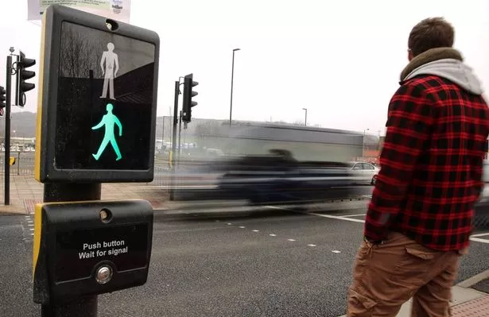
THANK YOU!

